Slide 1
Gen AI-Based Email Classification and OCR

Slide 2
LLM Model
Used LLM Model “gemini-2.0-flash” for pre processing email content and for email classification to the configured Request, Sub Request Types and confidence score.
Used OCR to read content from Image, PDF

Slide 3
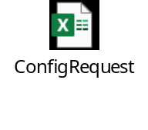
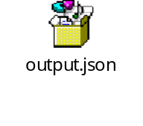
Solution Description
This solution will read the configurable request, sub request type from the given csv file “ConfigRequest.csv”, and it will read and process the each outlook file(.msg) from the specified folder “Emails” and will return “filename” and its request type, subrequest type, confidance score, priority (email or attachment), Intent, high level data [Named_Entities: (List of important names,Loan Details, organizations, dates, product names)
Please find the above attached sample output json, configurable data.

Slide 4
High level steps performed for the desired output
Performed the below steps looping through each outlook email file (.msg) from the folder.
Reading the outlook file (.msg) : It will read and extract content of subject, email body and content from attachments if exists. Currently it will supports reading of attachments of type Image, PDF, Word Files. (used OCR for PDF, Image content extraction)
Pre Processing Email Content: To get more accurate result I have performed this step. I have removed the below data from email content to get better result.
    Disclaimers
    Warnings
    Signatures
    I have used Gemini LLM model api to perform this step.
Email Classification: I have used llm model api to get below result by passing email data, configured request, sub request types.
  Intent
  request_type
  request_confidence
  sub_request_type
  Priority
  Named_Entities (key data from body, attachements. eg: Loan Number:12345, Company Name: SAYS Pvt Ltd etc)

